Slide 1
Sales Performance Analysis
An Overview of Key Sales Insights and Strategic Recommendations
Prepared by:
Ashutosh Pathak
Chetan Raja Nayak
Saran Baskar
Yashas Nagaraju Raj
Date of Submission: Nov 06th , Wednesday

Slide 2
Objectives and Overview of the Data
Objectives:
Provide actionable insight
Identify key trends and patterns to guide strategic business decisions.
Dataset Overview
Analyzed multi-year data covering metrics like sales, profit, region, and customer segment.
Offers a comprehensive view of performance across products, regions, and customer groups to pinpoint growth and optimization areas.
Data Processing Summary
Data was cleaned and transformed for accurate analysis.
Created hierarchies (e.g., Product and Geographic) and calculated key metrics (e.g., profit margin, previous year sales).
Enabled clearer, more meaningful visualizations to highlight business opportunities.

Slide 3
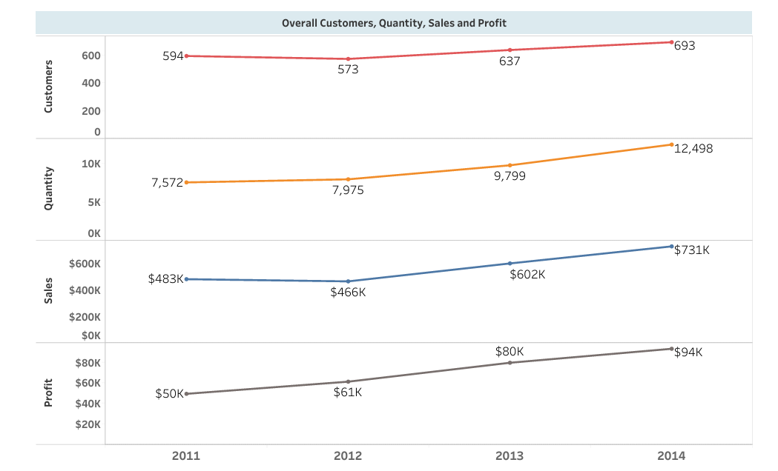
Growth in Sales, Orders, and Profit Over Time
Insights
Steady Increase in Customers: The number of customers has gradually increased each year, reaching 693 in 2014.
Orders: Growth in orders have shown a consistent upward trend, with a significant rise from 7,572 in 2011 to 12,498 in 2014.
Rising Sales Revenue: Sales have grown steadily over the years, starting from $483K in 2011 and reaching $731K in 2014.
Increasing Profit: Profit has also increased year over year, from $50K in 2011 to $94K in 2014, indicating improved profitability.
Strategic Implication:
Although profit has grown, it lags behind the rate of increase in sales. A focus on cost optimization, product mix, or pricing adjustments could help improve the profit margin and enhance profitability further.

Slide 4
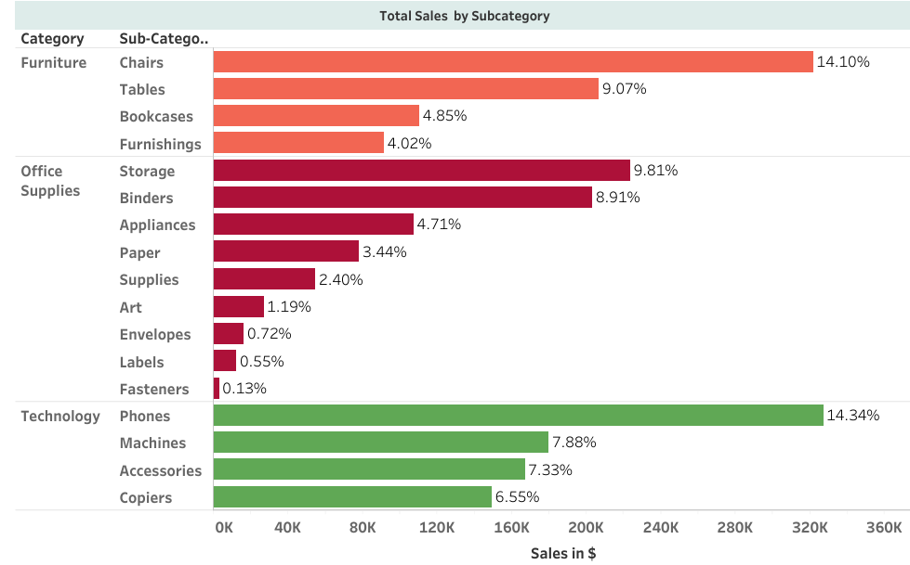
Total Sales by Subcategory
Insights
Top Subcategory - Phones: Phones lead all subcategories in sales, contributing 14.34% of total sales. This indicates a strong demand in the Technology category.
Strong Sales in Chairs and Storage: Chairs (14.10%) in Furniture and Storage (9.81%) in Office Supplies are also high-performing subcategories, showing significant contributions within their respective categories.
Low Sales in Fasteners, Labels, and Envelopes: Subcategories like Fasteners (0.13%), Labels (0.55%), and Envelopes (0.72%) contribute minimally to overall sales, indicating low demand for these items.
Strategic Implication:
Product Review for Low-Demand Items: Fasteners, Labels, and Envelopes have minimal sales contribution. Management could review these subcategories to consider reducing inventory, offering targeted promotions, or assessing whether these items should continue to be offered.

Slide 5
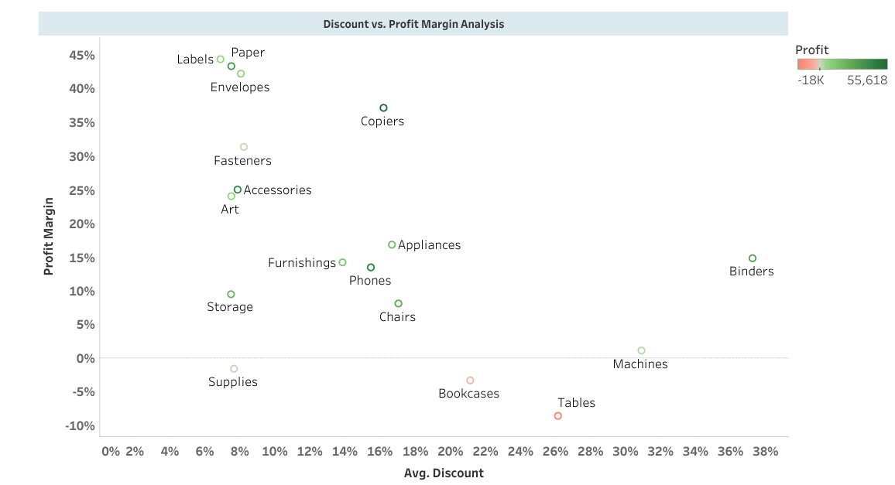
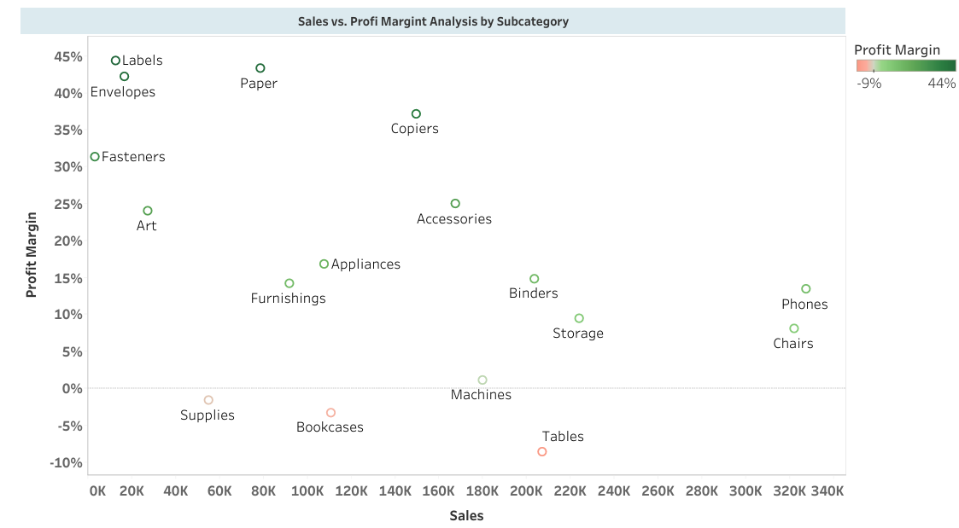
Profit Margin Analysis by Discount and Sales
Insights:
High Discount, Low Profit Margin: Subcategories like Supplies and Bookcases have high discount rates but very low or negative profit margins..
Items with Low Margins: Machines and Tables have low or negative profit margins despite considerable sales and discount levels.
Strategic Implications
High Discount, Low Profit Margin: consider reducing discount rates for these subcategories to improve overall profitability without significantly impacting sales..
Items with Low Margins: A re-evaluation of pricing and discounting strategies is recommended for these subcategories to ensure they contribute positively to overall profitability.

